Slide 1
Mpox Update
Harry J Brown, MD
Medical Epidemiologist
United South and Eastern Tribes, Inc. – Tribal Epidemiology Center
January 20, 2023

Slide 2
Update Summary
Mpox is the new name chosen by WHO for monkeypox
Public Health Emergency expires on January 31, 2023
This probably will not really affect anything, since the vaccine is already approved, and medications are approved

Slide 3
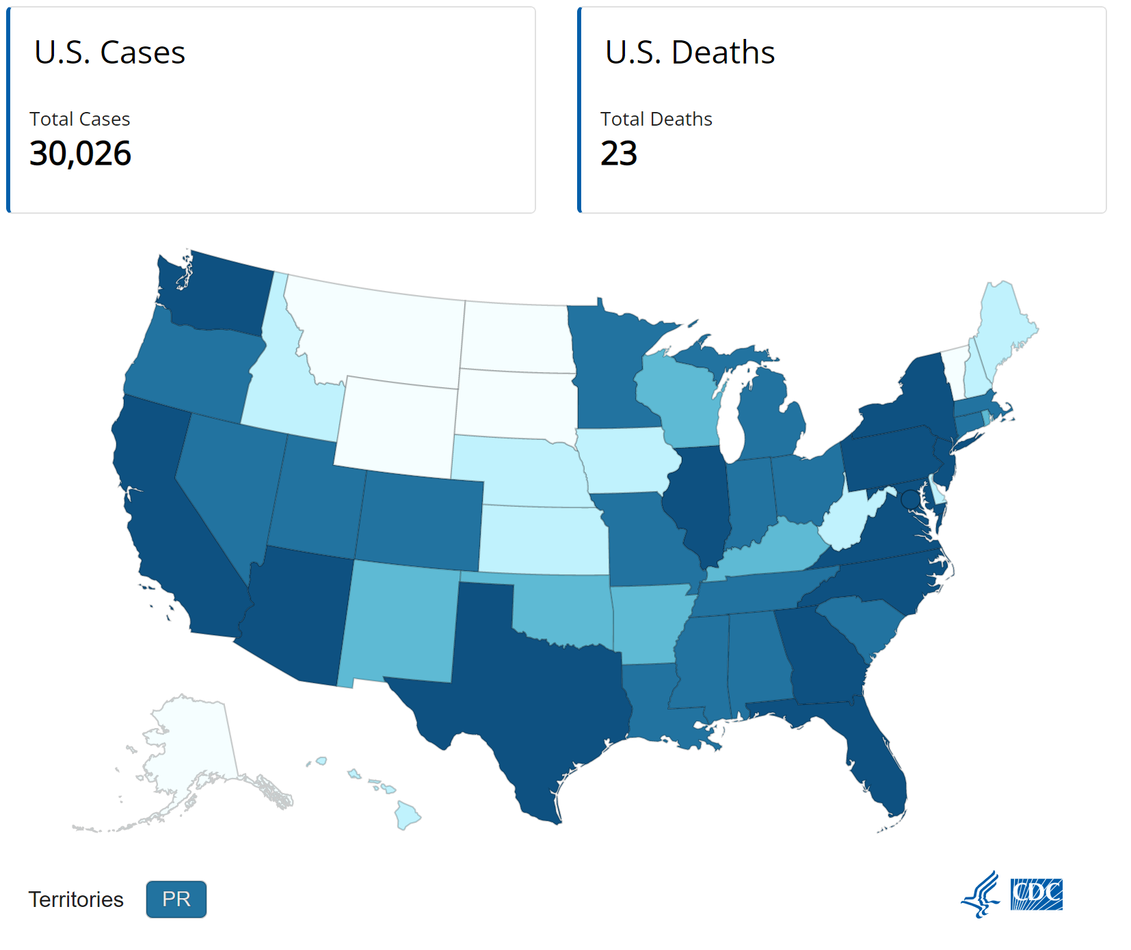
Total Cases
Cases vary greatly by geography
Global cases: 84,901

Slide 4
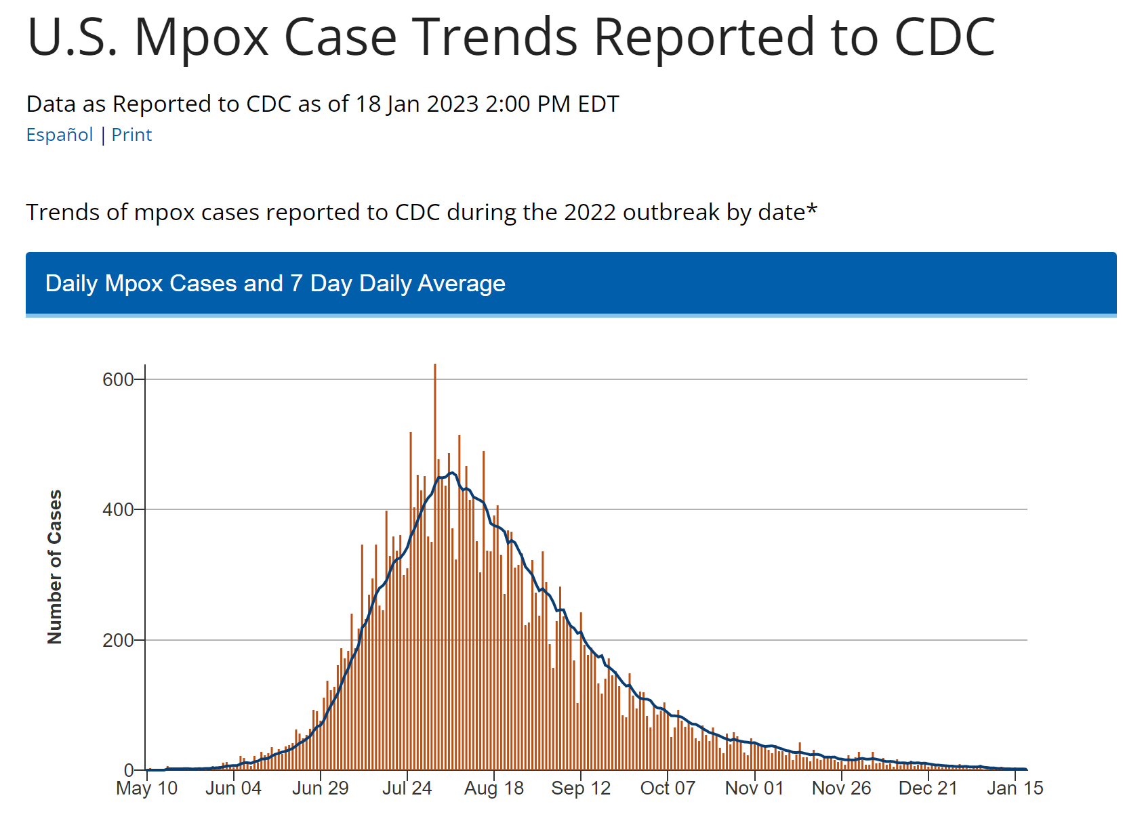
New Cases Trending Down
Cases now in the single digits
Expect this trend to continue

