Slide 1
Streptococcal Pharyngitis and Complications
Harry J Brown, MD
Medical Epidemiologist
United South and Eastern Tribes, Inc. – Tribal Epidemiology Center
January 20, 2023

Slide 2
Outline
Differential Diagnosis of Sore Throat
Group A Streptococcus – microbiology, epidemiology
Streptococcal Pharyngitis
  Clinical features
  Diagnosis
  Treatment
Complications of Streptococcal Pharyngitis

Slide 3
Case Presentation
7 year old male presents to the Emergency Room at 8 PM with onset that afternoon of abdominal pain, nausea, and vomiting. A CBC was done before the patient was actually evaluated by a provider. It came back with a WBC of 17,500. Without examining the patient, the doctor orders a CT scan of the abdomen and pelvis, with a request that says “R/O appendicitis”. The Xray tech notifies the radiologist, who contacts the doctor for more information before doing a CT scan on this child.
One of the ER nurses talks to the mother, who tells her that the child has also mentioned that it hurts to swallow. The nurse looks in the child’s mouth and sees this:

Slide 4
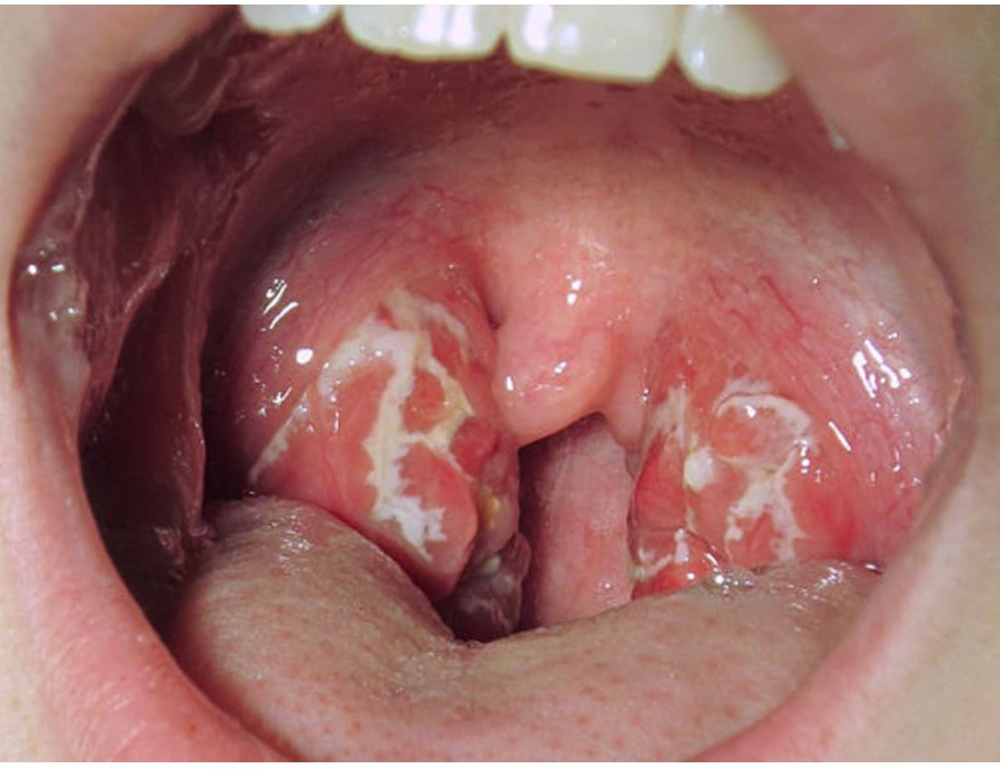
What the nurse saw:

Slide 5
Case Presentation, continued
The doctor decides to take a history and examine the child. The child has the following physical findings:
Temperature of 39 C (102.2 F), pulse 120, other VS wnl
Tonsils enlarged with white exudate
Anterior cervical nodes tender and swollen
Abdomen with normal bowel sounds, soft, nontender to palpation
No runny nose, cough, diarrhea
No enlarged spleen or other lymphadenopathy

Slide 6
What should be the next step in this patient?

Slide 7
Differential Diagnosis of Sore Throat - Viral
Adenovirus
Coxsackie virus
Epstein-Barr virus
Cytomegalovirus
Human immunodeficiency virus (HIV)
Influenza A and B
SARS-CoV-2
Herpes simplex 1 and 2

Slide 8
Differential Diagnosis of Sore Throat - Bacterial
Group A streptococcus (also Group C and G)
Arcanobacterium haemolyticum
Neisseria gonorrhoeae
Fusobacterium necrophorum (Lemierre syndrome)
Corynebacterium diphtheriae (diphtheria)
Francisella tularensis (tuleremia)

Slide 9
Sore Throat – other infectious causes
Mycoplasma pneumoniae (5 to 16% in children >5)
Chlamydia pneumoniae
Treponema pallidum (secondary syphilis)
Candida (thrush)

Slide 10
Sore Throat – noninfectious causes
Mucosal drying from mouth breathing or forced air heat
Foreign body
Chemical exposure
Referred pain (from other infections, such as tooth abscess, ear infection, etc.)
Smoking

Slide 11
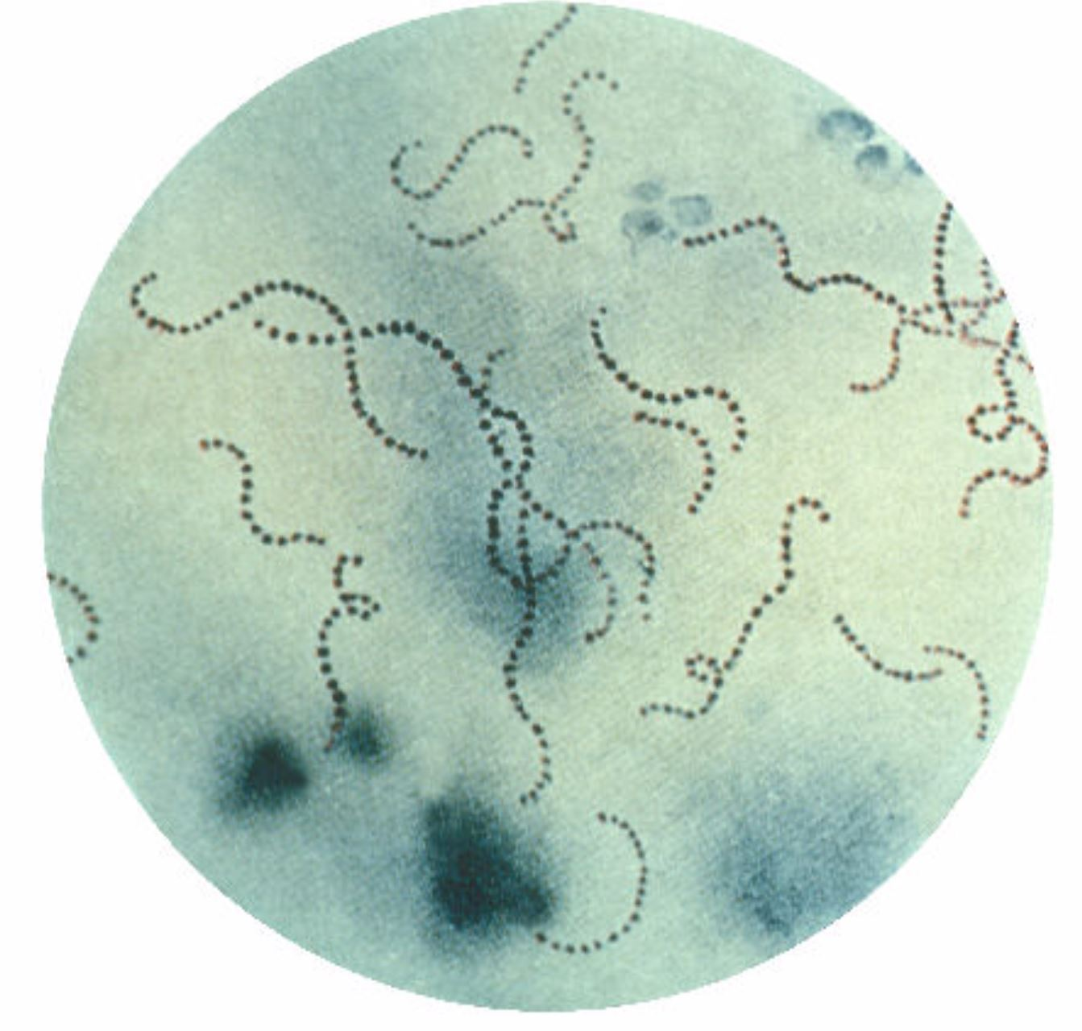
Group A Streptococcus
Gram positive cocci in chains
AKA Streptococcus pyogenes or abbreviated as GAS
Most common cause of bacterial pharyngitis in children and adolescents
Accounts for 15 – 30% of pharyngitis in children between 5 and 15 years
Accounts for 5 – 15% of pharyngitis in adults
Peaks in late winter, early spring
From CDC Public Health Image Library

Slide 12
Group A Streptococcus (GAS)
Produces a number of toxins
Beta hemolytic (caused by streptolysin S toxin)
Only known reservoir is human skin and mucous membranes
Also causes skin and soft tissue infections
Incubation period: 24 to 72 hours
Relatively uncommon in children under the age of 3 years

Slide 13
Streptococcal Pharyngitis - Symptoms
Abrupt onset
Sore throat
Fever
Headache
Abdominal pain
Nausea / Vomiting
Infants and children less than 3 may present with nonspecific symptoms

Slide 14
Streptococcal Pharyngitis – Physical Findings
Tonsillopharyngitis, often exudative
Enlarged, tender anterior cervical lymph nodes
Palatal petechiae
Uvulitis
Scarlatiniform rash

Slide 15
Streptococcal Pharyngitis – other clinical
Viral features are uncommon, but might be present occasionally: runny nose, conjunctivitis, cough, hoarseness, diarrhea, discrete ulcerative lesions or vesicles, anterior stomatitis
It is possible to have a concurrent viral infection AND streptococcal pharyngitis
Usually will get better in 3 to 5 days with OR without treatment (treatment with antibiotics usually results in less severity and faster recovery time)

Slide 16
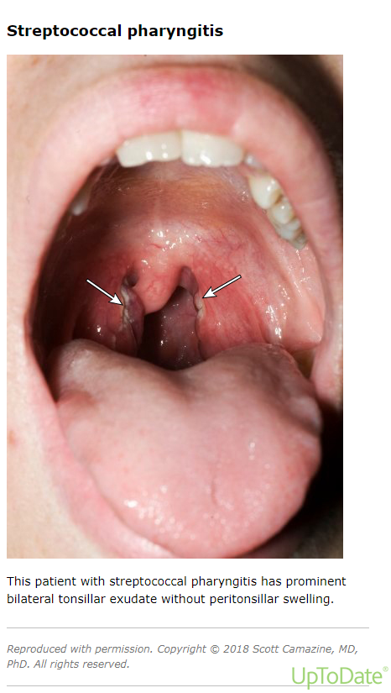

Slide 17
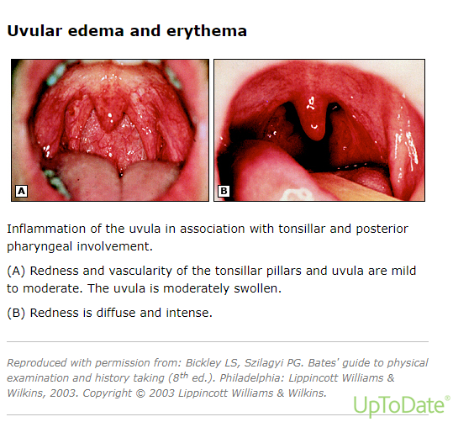

Slide 18
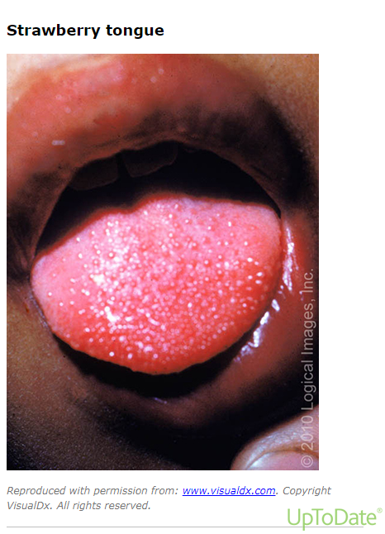

Slide 19
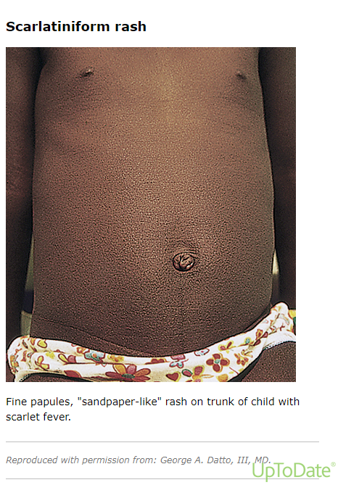

Slide 20
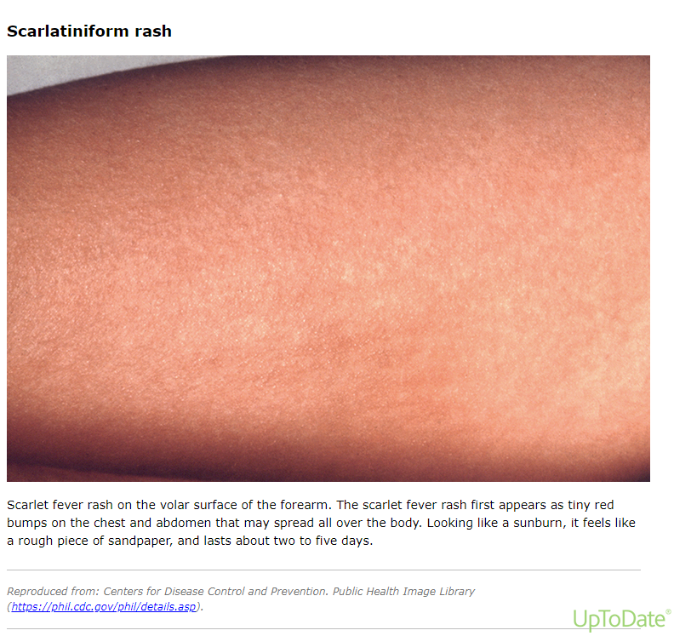

Slide 21
Streptococcal Pharyngitis - Diagnosis
Why is it important to make a definitive diagnosis?
Proper treatment of streptococcal pharyngitis in order to:
  Prevent complications
  Prevent transmission
  Reduce the duration and severity of symptoms
No clinical signs or symptoms are diagnostic
Testing is necessary to make a definitive diagnosis

Slide 22
Before making the diagnosis of streptococcal pharyngitis:
Must rule out serious causes of sore throat:
Epiglottitis
Retropharyngeal abscess
Lateral pharyngeal abscess
Peritonsillar abscess
Severe tonsillar hypertrophy
Beware: drooling, stridor, respiratory distress, change in voice

Slide 23
Streptococcal Pharyngitis: Who to Test?
Acute tonsillopharyngitis or scarlatiniform rash with the absence of viral symptoms
Also test individuals with known exposure with symptoms
Children under 3 may present with an atypical picture:
  Prolonged nasal discharge
  Tender anterior cervical nodes
  Low grade fever (< 101 F)

Slide 24
Streptococcal Pharyngitis: Who to Test?
Centor criteria:
Fever
Absence of cough
Presence of tonsillar exudates
Swollen, tender anterior cervical lymph nodes
If 2 or more of these criteria present, then test

Slide 25
Streptococcal Pharyngitis: Tests
3 Types of Tests Available:
RADT – Rapid Antigen Detection Test – high specificity (>95%), variable sensitivity (70 to 90%)
Throat culture – gold standard
Molecular test for GAS (NAAT) – high sensitivity (>95%), but also higher cost and complexity

Slide 26
Streptococcal Pharyngitis: Testing
If features are strongly suggestive of viral illness, do NOT test, and treat symptomatically
If strep suspected, may do RADT
  If RADT is positive, treat with antibiotics (high specificity)
  If RADT is negative in a child, follow up with throat culture (low sensitivity, may miss up to 30% of cases)
  If RADT is negative in an adult, no need for f/u culture (less common in adults, and acute rheumatic fever uncommon in adults)
If molecular test is negative, no need for f/u culture

Slide 27
Streptococcal Pharyngitis: Treatment
Penicillin is antibiotic of choice
  Penicillin V, amoxacillin, benzathine penicillin G given IM
Alternatives in penicillin allergy
  Cephalosporins
  Clindamycin
  Clarithromycin
  Azithromycin

Slide 28
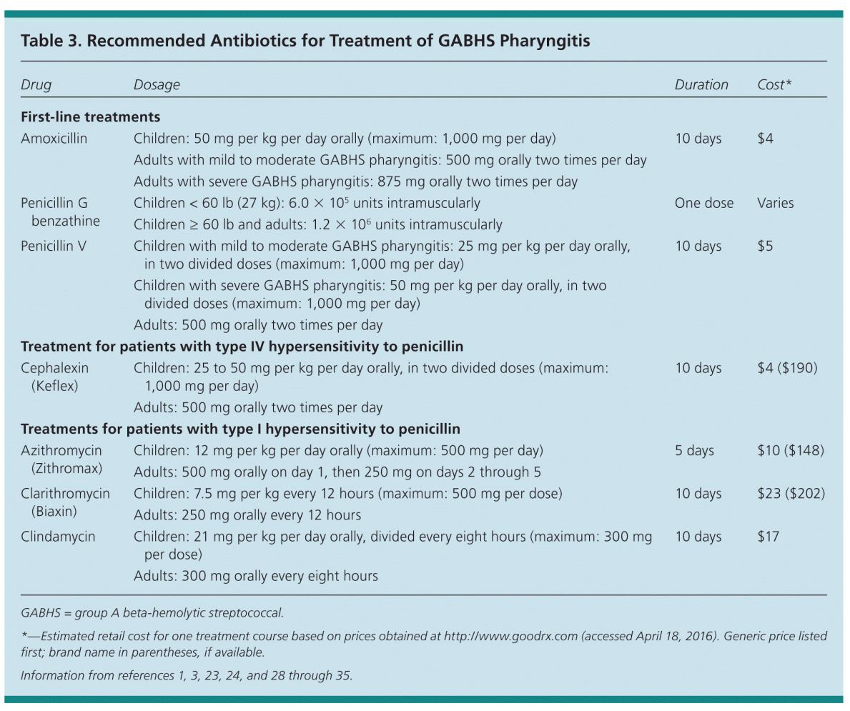
Antibiotics for Streptococcal Pharyngitis
From American Family Physician 2016; 94(1): 24-31 (Jul 1, 2016)

Slide 29
Complications of Streptococcal Pharyngitis
Suppurative Complications
  Sinusitis and Otitis media
  Peritonsillar abscess
  GAS bacteremia
  Toxic shock syndrome
  Necrotizing fasciitis
Non-suppurative Complications
  Acute rheumatic fever
  Poststreptococcal glomerulonephritis

Slide 30
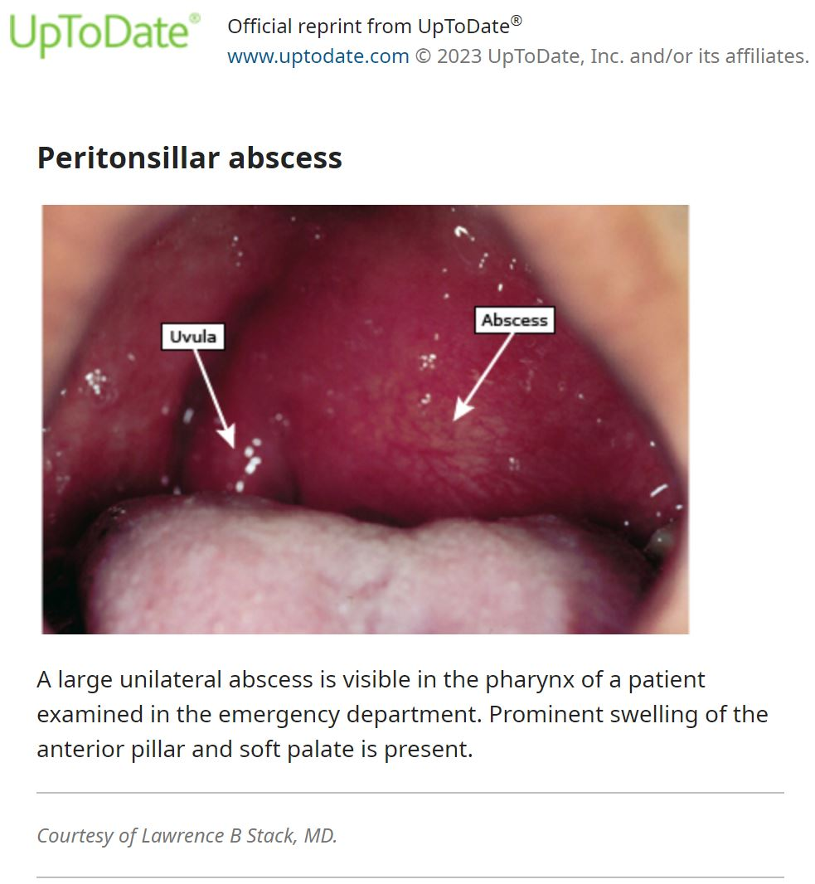
Peritonsillar Abscess

Slide 31
Group A Streptococcal Bacteremia
An increased number of cases reported from 5 European countries (France, Ireland, Netherlands, Sweden, UK) in 2022
Most affected group is children under 10
Some deaths have occurred
Increase in scarlet fever noted as well
Small number of subtypes responsible for bacteremia – all produce toxin known as NADase
Greater risk among immunocompromised and IVDU

Slide 32
Acute Rheumatic Fever
Follows GAS pharyngitis by 2 to 3 weeks
Most common in children 5 to 15 years old
Occurs at a much higher rate in economically disadvantaged countries and populations
Often occurs as outbreaks
Can lead to permanent cardiac valve damage

Slide 33
Acute Rheumatic Fever
Major Jones Criteria
Minor Jones Criteria
Migratory arthritis
Pancarditis
Sydenham chorea (“St. Vitus dance”)
Erythema marginatum
Subcutaneous nodules
Arthralgia
Fever
Elevated acute phase reactants (ESR, CRP)
Prolonged PR interval

Slide 34
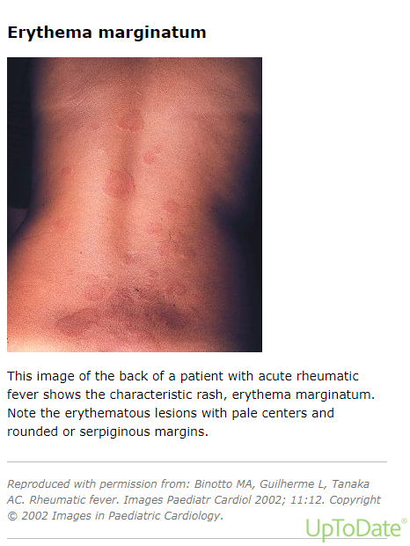

Slide 35
Poststreptococcal Glomerulonephritis
Children under 7 are at highest risk
Caused by specific strains (type 12, type 49)
Most cases have complete recovery
Severity ranges from microscopic hematuria to severe:
  Gross hematuria – red or brown urine
  Proteinuria
  Edema
  Hypertension
  Acute renal failure

Slide 36
Back to the Case Presentation
The doctor decides to take a history and examine the child. The child has the following physical findings:
Temperature of 39 C (102.2 F), pulse 120, other VS wnl
Tonsils enlarged with white exudate
Anterior cervical nodes tender and swollen
Abdomen with normal bowel sounds, soft, nontender to palpation
No runny nose, cough, diarrhea
No enlarged spleen or other lymph nodes

Slide 37
Summary
Group A Streptococcus is the most common bacterial cause of pharyngitis
More common in school-age children
Important to treat streptococcal pharyngitis to prevent complications
Testing is important to make the diagnosis (there is no certain way to make the diagnosis on clinical grounds alone)
Penicillin is still the antibiotic of choice

Slide 38
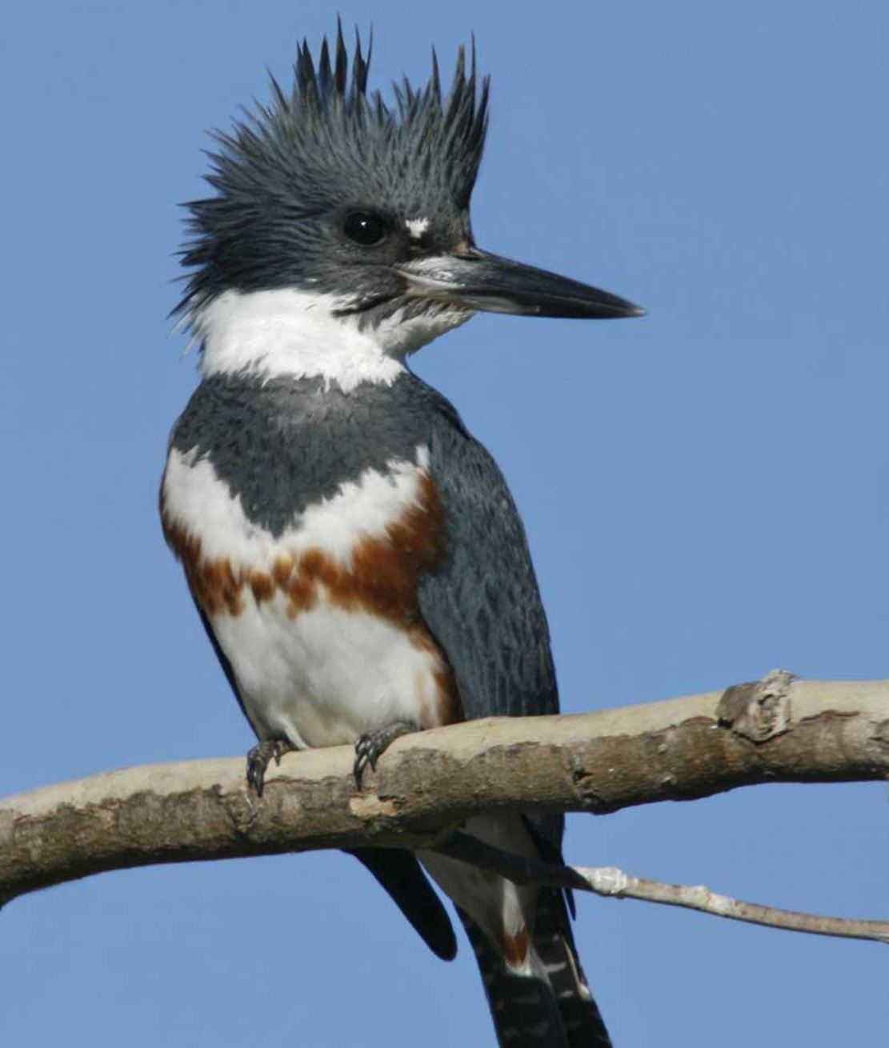
Thank You for Your Time and Attention!
Have a Good Weekend…
Harry J Brown
USET TEC
hbrown@usetinc.org
615-917-7526

