Slide 1
USET Infectious Disease ECHO
United South and Eastern Tribes (USET)
Tribal Epidemiology Center (TEC)
Christy Duke, MPH
Tribal Health Program Support Assistant Director
cduke@usetinc.org
January 20, 2023

Slide 2
USET TEC Epidemiology Update: COVID-19

Slide 3
USET COVID-19 Surveillance and Vaccination Reports
Data Sources
  COVID-19 Surveillance Report
    1.) Indian Health Service (IHS) Nashville Area Weekly COVID-19 Tracking Sheet
    2.) Centers for Disease Control and Prevention (CDC) COVID-19 Community Levels
    3.) Centers for Disease Control and Prevention (CDC) Wastewater Surveillance
    4.) Health and Human Services (HHS) Protect COVID-19 Data Hub
  COVID-19 Vaccination Report
    1.) Indian Health Service (IHS) COVID-19 Dashboard/ Vaccine Administration Management System (VAMS)
    2.) Centers for Disease Control and Prevention (CDC) COVID-19 Data Tracker

Slide 4
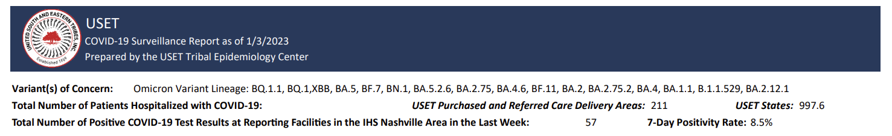
Nashville Area COVID-19 Epidemiology

Slide 5
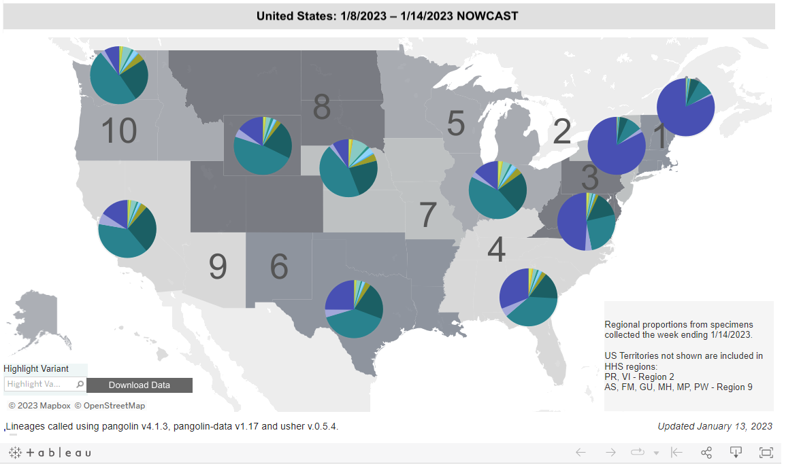
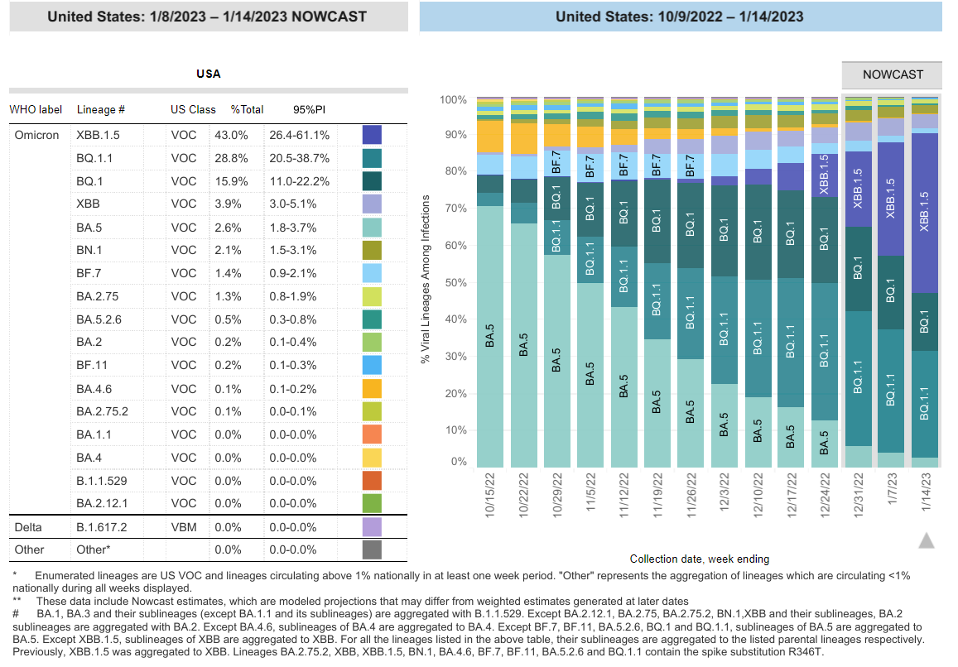
CDC Nowcast Variants as of 1/14/2023
Notes:
XBB.1.5 rapidly increasing in proportion of variants circulating across USA
Very large proportions of XBB.1.15 in NE region (dark blue)

Slide 6
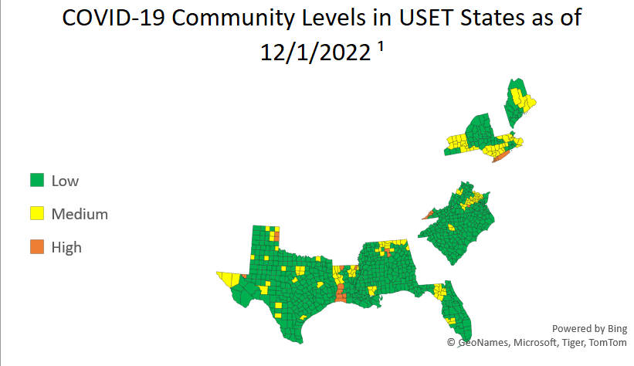
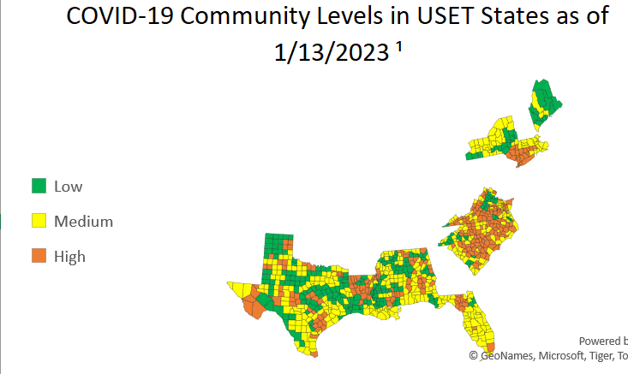
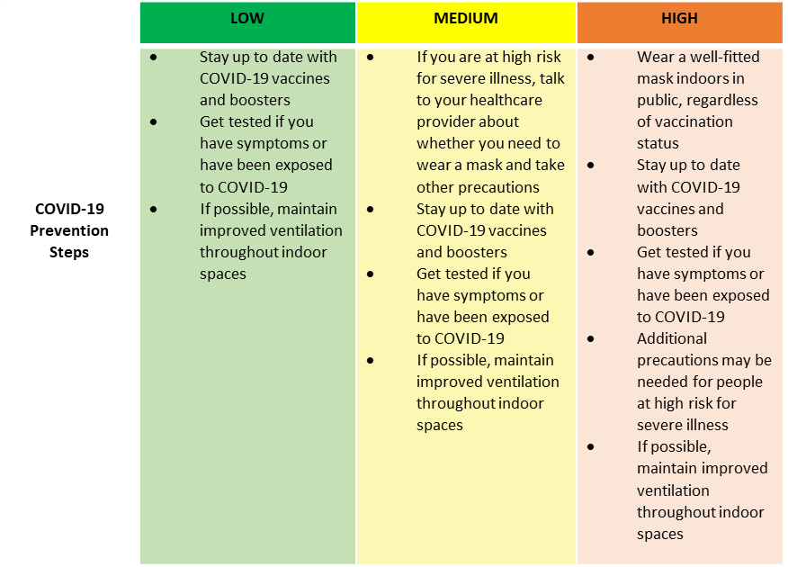
CDC COVID-19 Community Levels in USET States

Slide 7
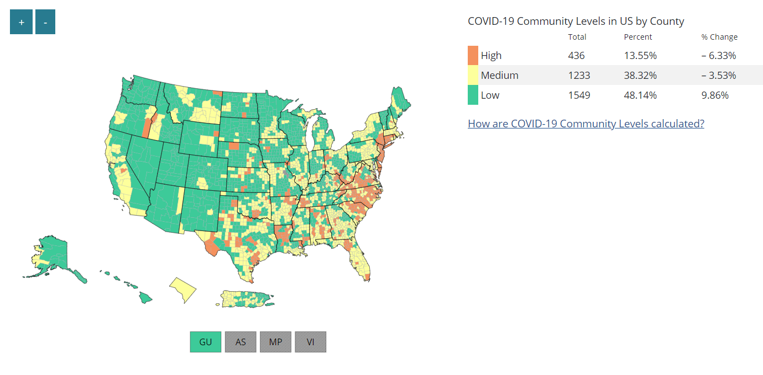
USA Community Levels as of 1/13/2023
Notes:
Whole picture of USA community levels (for added context)- USET region in USA increasing community levels vs west

Slide 8
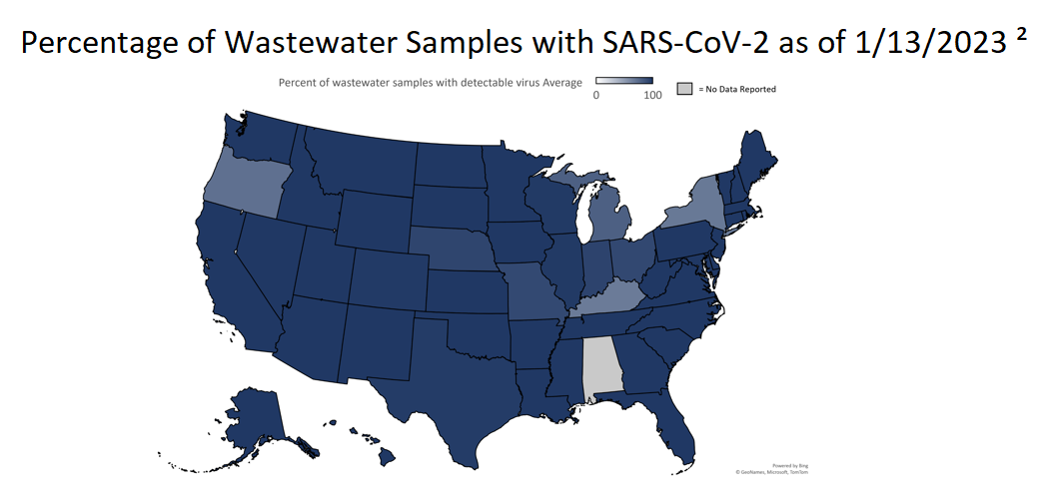
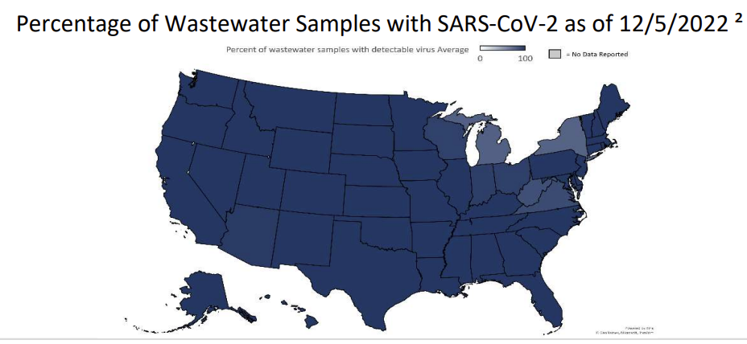
CDC COVID-19 National Wastewater Surveillance

Slide 9
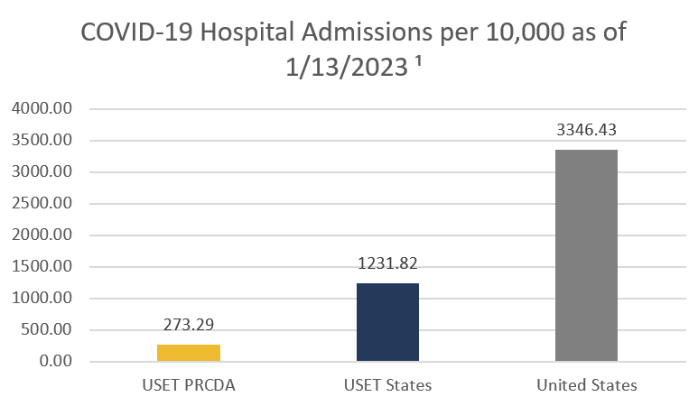
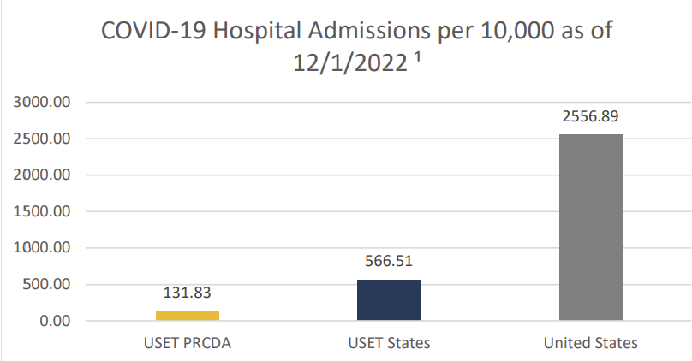
COVID-19 Hospital Admissions

Slide 10
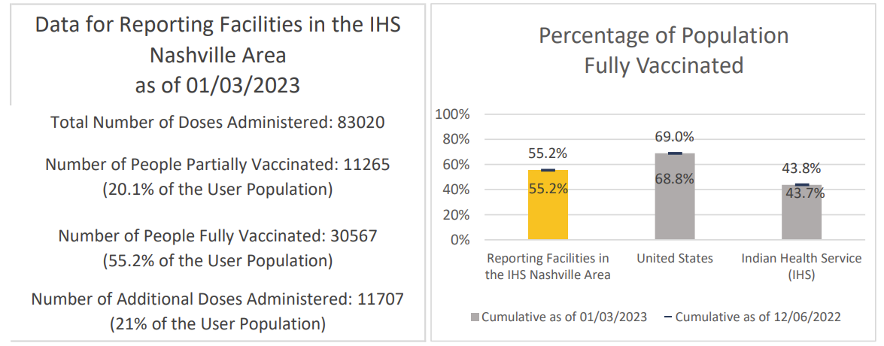
COVID-19 Vaccination Data

Slide 11
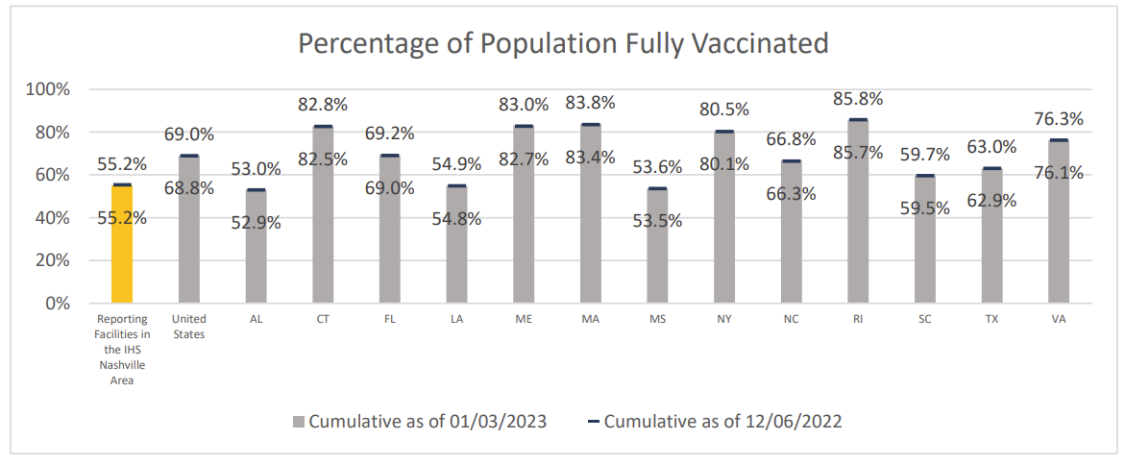
COVID-19 Vaccination Data

Slide 12
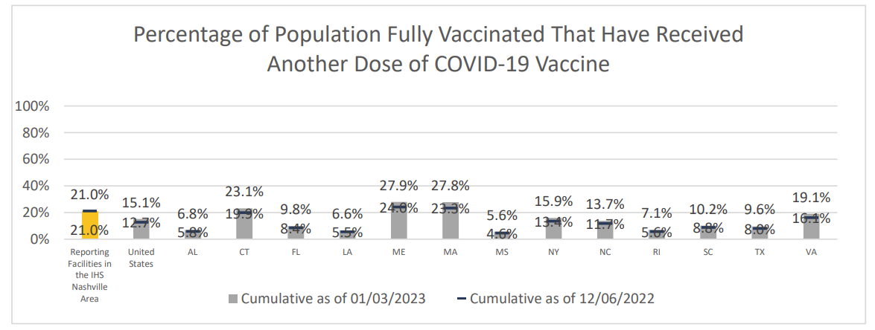
COVID-19 Vaccination Data

Slide 13
Data Sources: CDC COVID-19 Websites
SARS-CoV-2 Variant Classifications and Definitions
https://www.cdc.gov/coronavirus/2019-ncov/variants/variant-classifications.html#:~:text=Variants%20of%20concern%20might%20require,vaccines%20and%20treatments%20against%20the
COVID-19 Community Levels
https://www.cdc.gov/coronavirus/2019-ncov/science/community-levels.html
National COVID-19 Wastewater Surveillance
https://covid.cdc.gov/covid-data-tracker/#wastewater-surveillance
COVID-19 Vaccinations in the United States
https://covid.cdc.gov/covid-data-tracker/#vaccinations_vacc-people-onedose-pop-5yr

Slide 14
USET TEC Epidemiology Update: Influenza

Slide 15
USET Influenza Surveillance and Vaccination Report
Data Sources
  CDC Weekly Influenza Report https://www.cdc.gov/flu/weekly/
    Percentage of Positive Influenza Tests Reported to CDC
    Percentage of Visits for Influenza Like Illness (ILI) Reported by ILI Net
    Number of New Influenza Hospital Admissions Reported to HHS Protect
    Influenza Like Illness Activity Level by State
    Percentage of Outpatient Visits for Respiratory Illness Reported By The U.S. Outpatient Influenza-like Illness Surveillance Network
  Indian Health Service Weekly Influenza Report
    Percentage ILI Visits for National IHS
    Percentage ILI Visits for Nashville Area
    Seasonal Influenza Vaccination by IHS Region and Age Group

Slide 16
General Information- Biweekly Report
This data aims to provide a general overview on the current incidence of influenza and vaccination across the United States, within Indian Health Services, and specifically within the Nashville region
Data is reported by Morbidity and Mortality Weekly Report (MMWR) week
  The MMWR week is the week of the epidemiologic year for which the National Notifiable Diseases Surveillance System (NNDSS) disease report is assigned by the reporting local or state health department for the purposes of MMWR disease incidence reporting and publishing
Influenza Like Illness visits for respiratory illness that includes fever plus a cough or sore throat, not laboratory confirmed influenza and may include patient visits due to other respiratory pathogens that cause similar symptoms

Slide 17
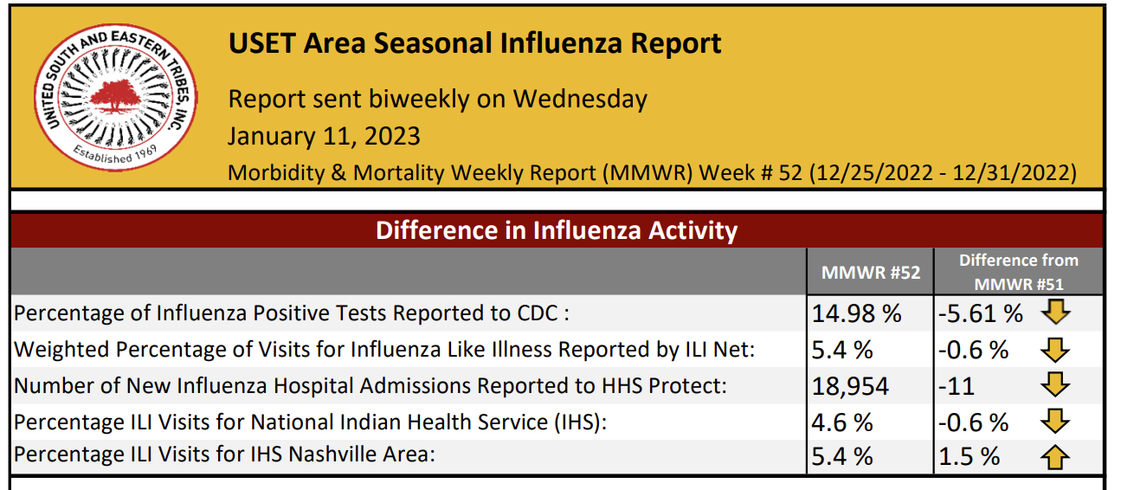

Slide 18
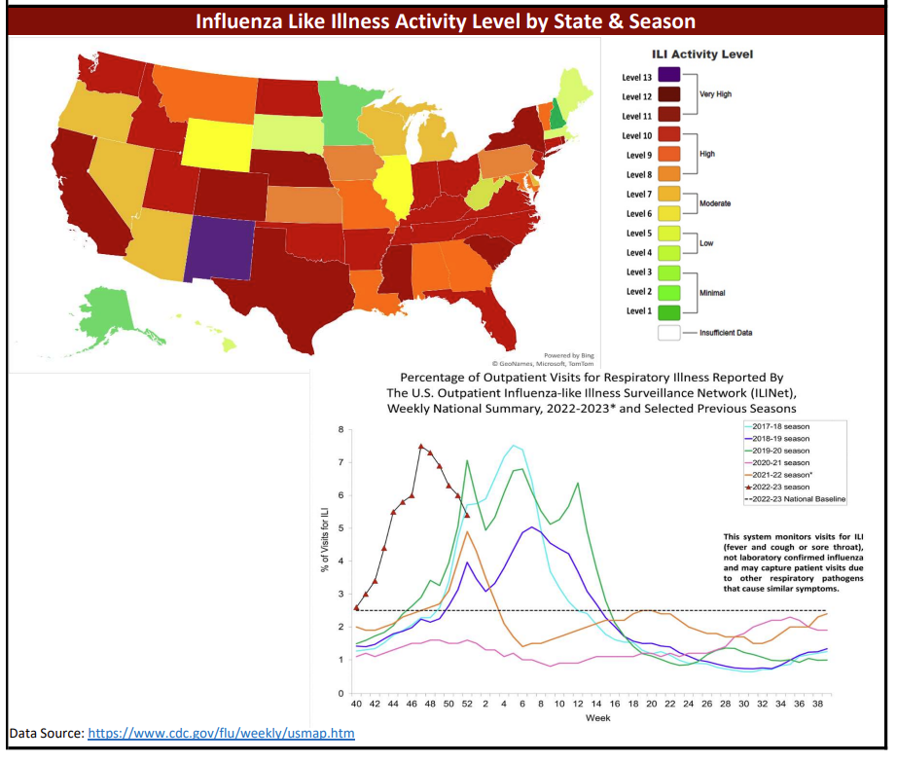

Slide 19
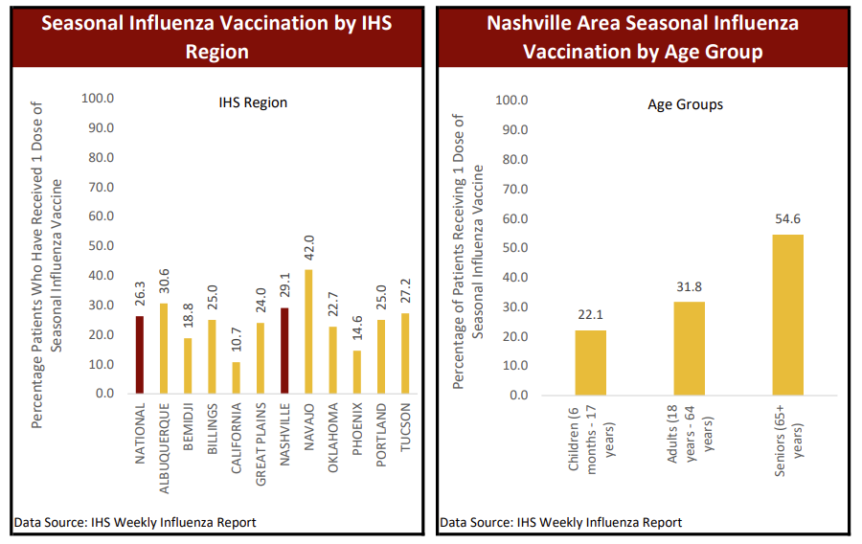

Slide 20
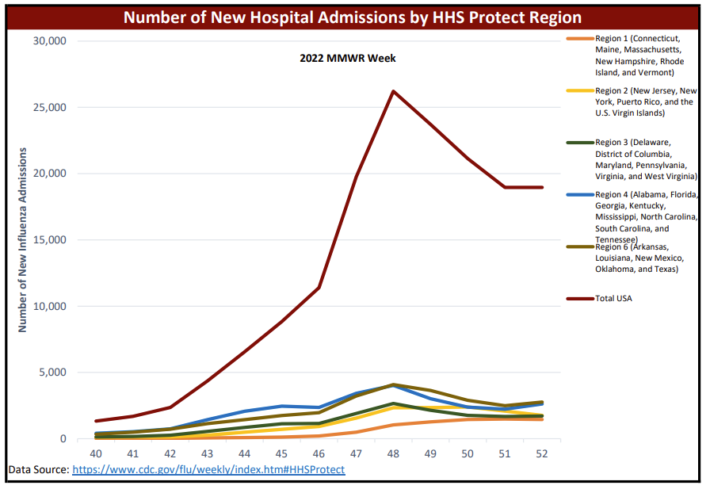

Slide 21
Questions?
Please contact us at usetepi@usetinc.org if you have questions, concerns, or require general assistance.
For feedback or questions about Influenza or COVID-19 Reports, please contact Staff Epidemiologist, Anna Garrett at agarrett@usetinc.org
Thank You!

